Slide 1
Dean

Slide 2

Plot
Dean Pelman is a former Florida Gator that underwent Tommy John surgery. He has spent a long journey rehabbing and after working a second job as MLB free agent, he is now preparing to go to the Olyumpics for Team Isreal after helping them qualify.

Slide 3
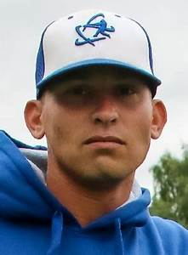
Purpose
Show the journey a Former Florida Gator student had to go through after a devasting injury that could be career ending if not taken care of correctly. He is one of so few people that will be able to participate in the Olympics and is inspiring.

Slide 4

People
Dean Pelman
Pitching Coach
Trainer
Will likely set b-roll of him throwing a bullpen session as well as training

Slide 5
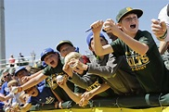
Audience
I think many young kids can look up to Pelman. He never got a chance to achieve his dream of playing at University of Florida due to his injury, but kept going and is very inspirational. He wants to share his journey with others.

Slide 6

Distribution
Weston, Florida
Baseball Fields
Gym
Zoom Interviews

